Slide 1

PneumoScan
CS
Institute of Space
Technology
Mobile App Development Presentation
Made by: Siraj Ahmad Khan, Umair Ahmad,

Slide 2

Introduction to the Application
CS
Institute of Space
Technology
Our Pneumonia Detection App uses advanced machine learning to analyze chest X-rays accurately and in real-time.
Enhances diagnostic capabilities, aiming to improve patient care and save lives.

Slide 3

Objectives
Why create Pneumonia Detection App?
To recognize if the individual has Pneumonia or not with high accuracy. so, the individual can look for treatment rapidly
To Offer resources to educate users about pneumonia, its symptoms, and the importance of early detection.
To use convolutional neural networks (CNNs), trained on large datasets of chest X-rays to identify pneumonia.

Slide 4

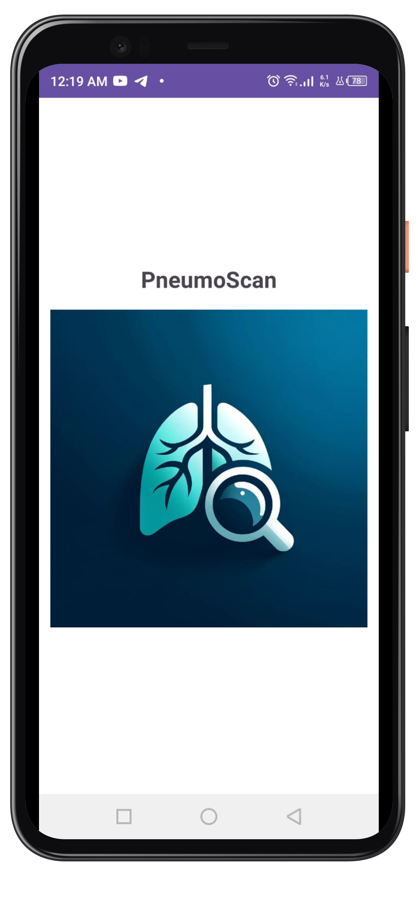
PneumoScan
How does the app work?
Splash Activity

Slide 5
PneumoScan
Splash Activity
How does the app work?

Slide 6
PneumoScan
Splash Activity
Handler(Looper.getMainLooper()).postDelayed({ val intent = Intent(this, MainActivity::class.java) startActivity(intent) finish() }, 3000) // 3000 milliseconds = 3 seconds
How does the app work?
Android Manifest
<activity android:name="com.example.PneumoScan.SplashActivity" android:exported="true" > <intent-filter> <action android:name="android.intent.action.MAIN" /> <category android:name="android.intent.category.LAUNCHER" /> </intent-filter> </activity>

Slide 7
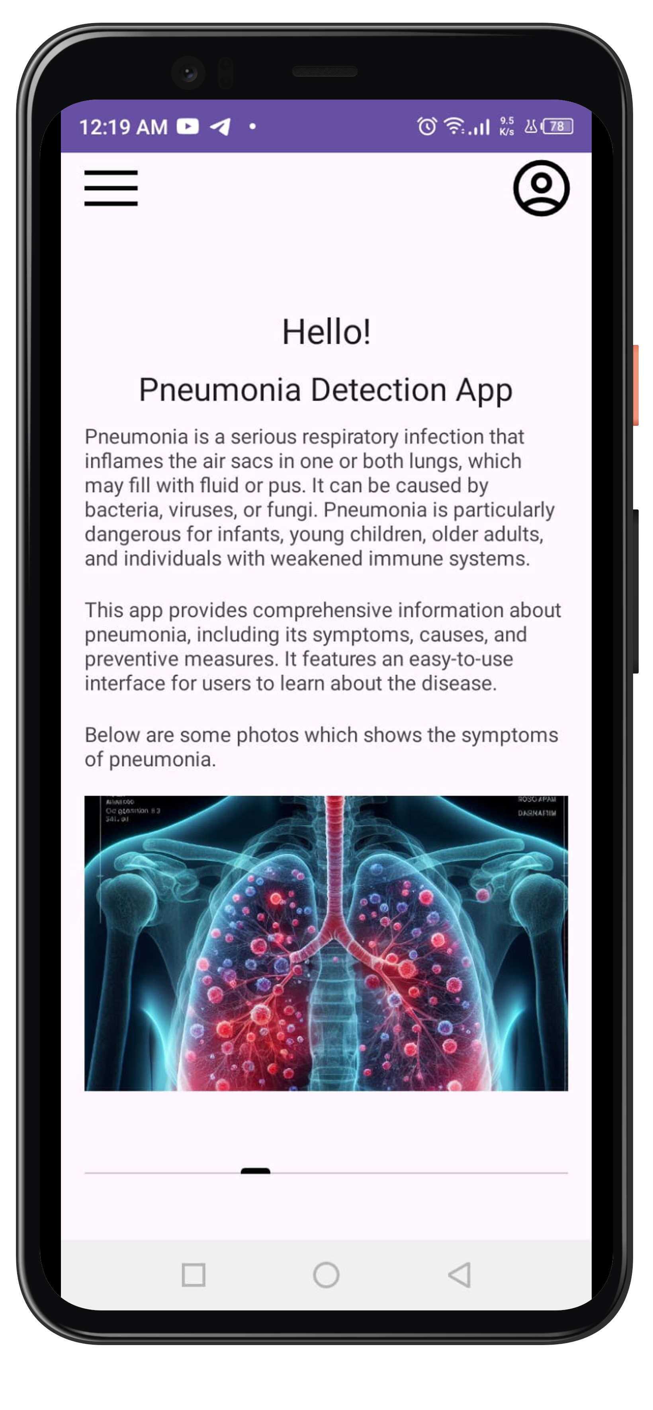
PneumoScan
Main Activity
class MainActivity : BaseActivity() {
private lateinit var viewPager: ViewPager2 private lateinit var adapter: ViewPagerAdapter private lateinit var tabLayout: TabLayout private lateinit var userId: String
How does the app work?
override fun onCreate(savedInstanceState: Bundle?) { super.onCreate(savedInstanceState) layoutInflater.inflate(R.layout.activity_main, findViewById(R.id.content_frame))

Slide 8
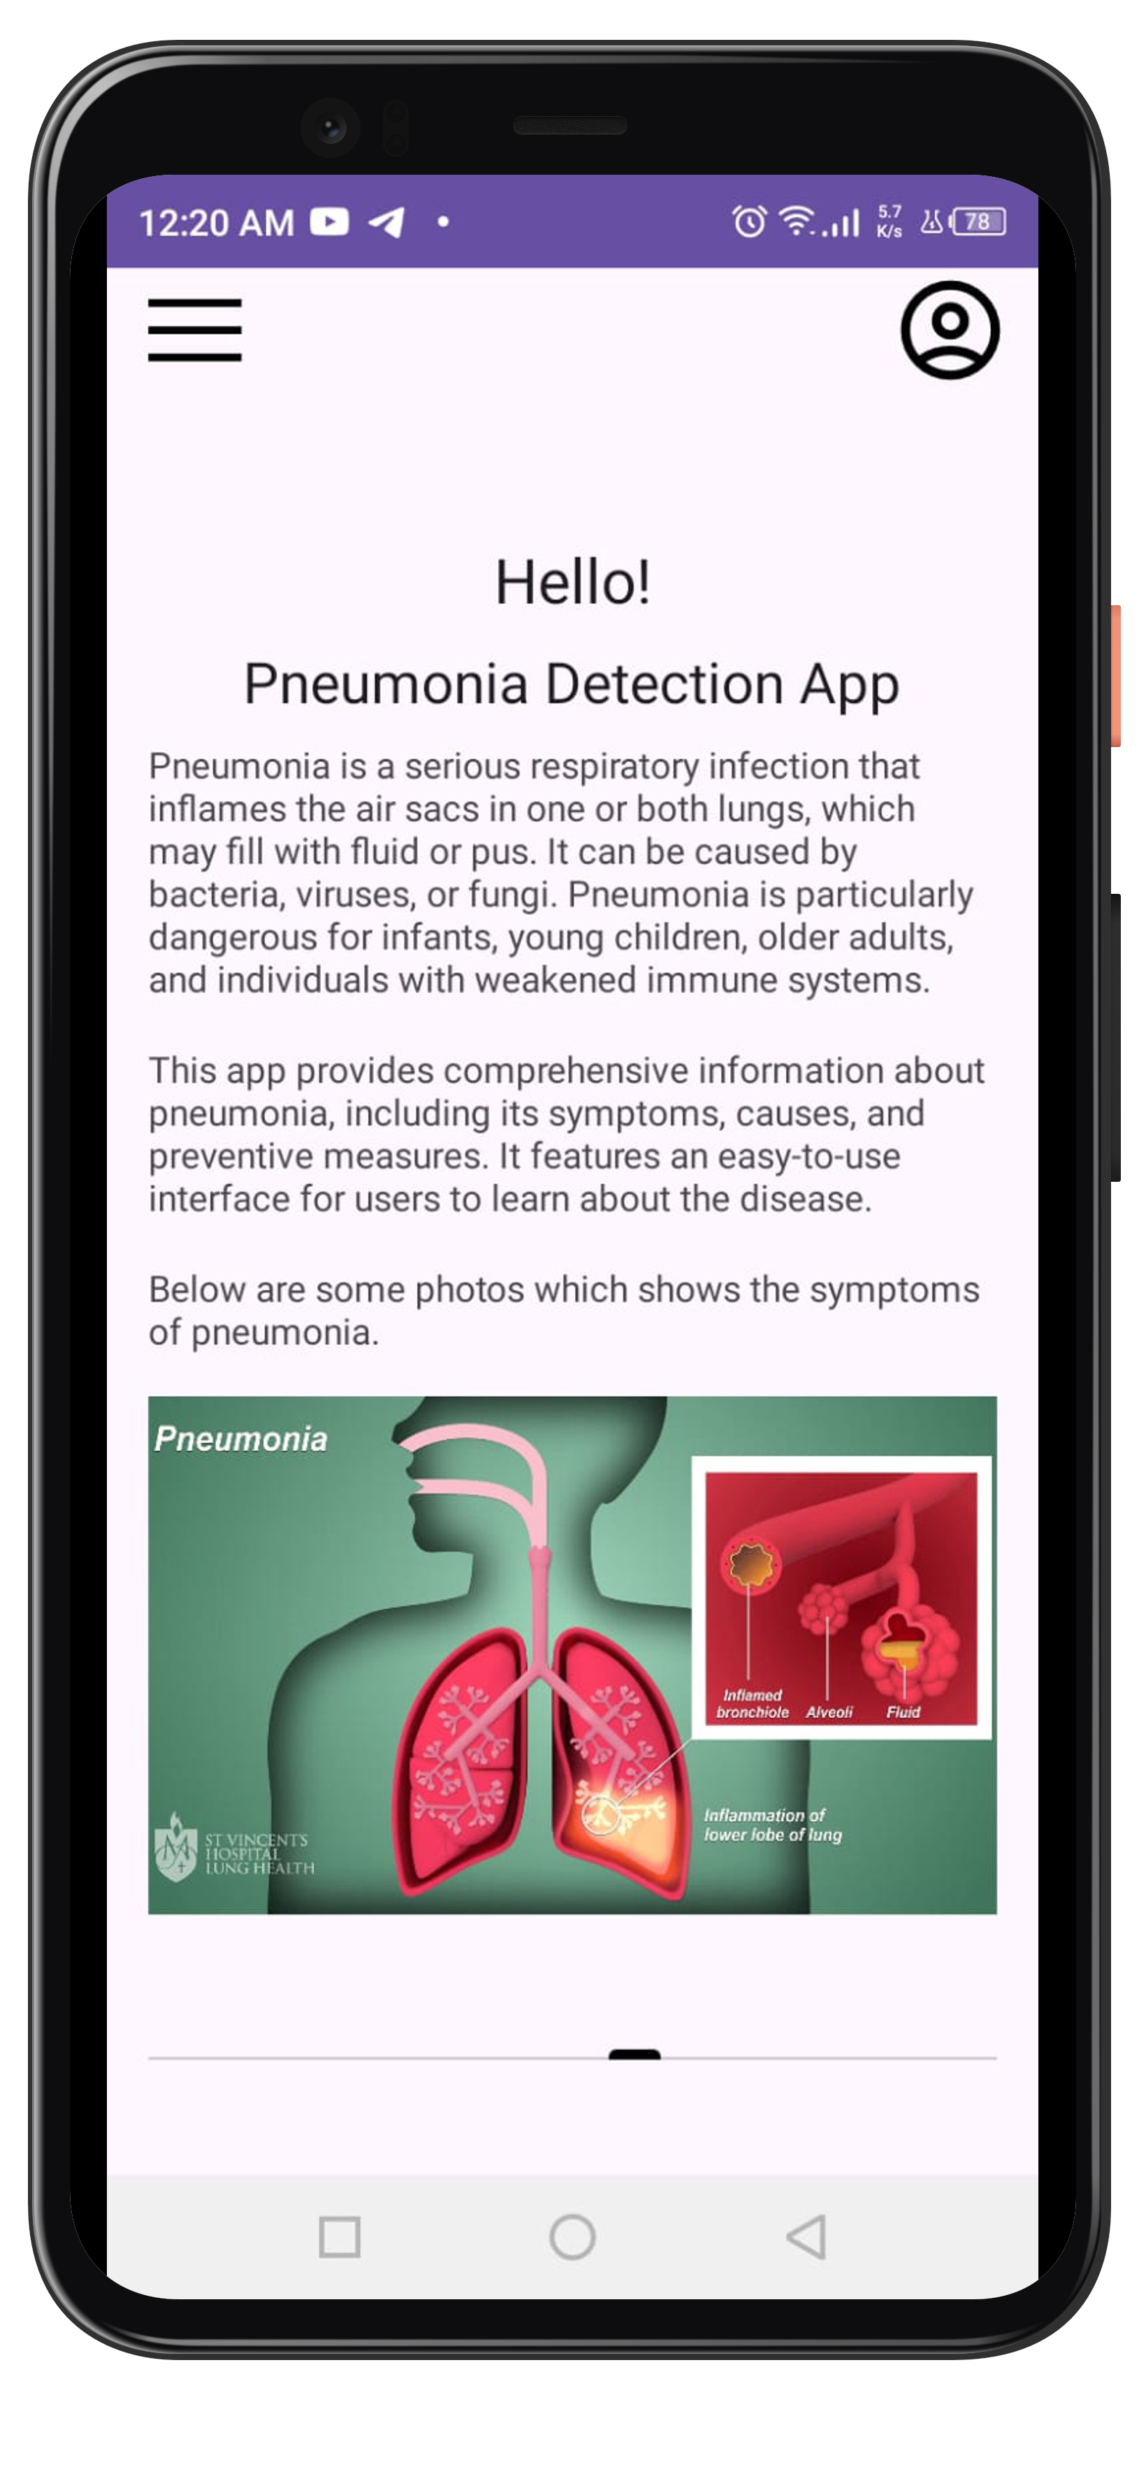
PneumoScan
Main Activity
class MainActivity : BaseActivity() {
private lateinit var viewPager: ViewPager2 private lateinit var adapter: ViewPagerAdapter private lateinit var tabLayout: TabLayout private lateinit var userId: String
How does the app work?
override fun onCreate(savedInstanceState: Bundle?) { super.onCreate(savedInstanceState) layoutInflater.inflate(R.layout.activity_main, findViewById(R.id.content_frame))
adapter = ViewPagerAdapter(this, images) viewPager.adapter = adapter TabLayoutMediator(tabLayout, viewPager) { tab, position -> // Setup tab if needed }.attach()

Slide 9
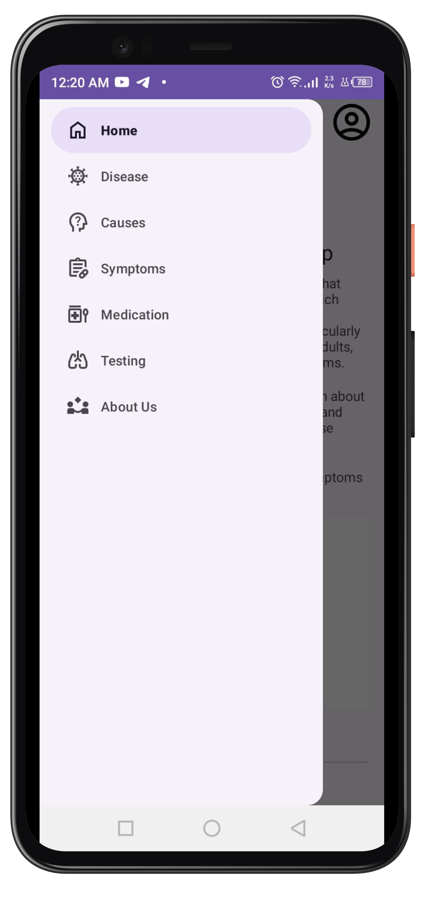
PneumoScan
Base Activity
open class BaseActivity : AppCompatActivity(), NavigationView.OnNavigationItemSelectedListener {
drawerLayout = findViewById(R.id.drawer_layout) navigationView = findViewById(R.id.nav_view) navigationView.setNavigationItemSelectedListener(this)
How does the app work?
toggle = ActionBarDrawerToggle( this, drawerLayout, R.string.navigation_drawer_open, R.string.navigation_drawer_close ) drawerLayout.addDrawerListener(toggle) toggle.syncState()
val navDrawerButton: ImageButton = findViewById(R.id.nav_drawer_button) navDrawerButton.setOnClickListener { drawerLayout.openDrawer(GravityCompat.START) } val profileButton: ImageButton = findViewById(R.id.profile_button) profileButton.setOnClickListener { val intent = Intent(this, AuthActivity::class.java) startActivity(intent) }

Slide 10
PneumoScan
Base Activity
override fun onNavigationItemSelected(item: MenuItem): Boolean { when (item.itemId) { R.id.nav_home -> { startActivity(Intent(this, MainActivity::class.java)) finish() } R.id.nav_disease -> { startActivity(Intent(this, DiseaseActivity::class.java)) finish() } R.id.nav_causes -> { startActivity(Intent(this, CausesActivity::class.java)) finish() } R.id.nav_symptoms -> { startActivity(Intent(this, SymptomsActivity::class.java)) finish() } R.id.nav_medication -> { startActivity(Intent(this, MedicationActivity::class.java)) finish() } R.id.nav_testing -> { startActivity(Intent(this, TestingActivity::class.java)) finish() } R.id.nav_aboutus -> { startActivity(Intent(this, AboutUsActivity::class.java)) finish() } } drawerLayout.closeDrawer(GravityCompat.START) return true }
How does the app work?

Slide 11
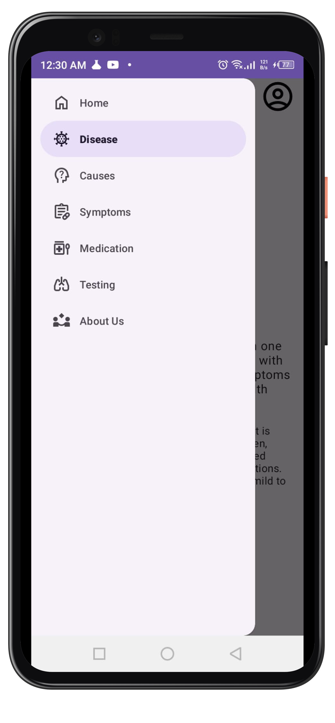
PneumoScan
Base Activity
protected fun setNavigationViewItemChecked(itemId: Int) { navigationView.setCheckedItem(itemId) }
How does the app work?
override fun onBackPressed() { if (this !is MainActivity) { val intent = Intent(this, MainActivity::class.java) intent.flags = Intent.FLAG_ACTIVITY_CLEAR_TOP or Intent.FLAG_ACTIVITY_SINGLE_TOP startActivity(intent) } else { super.onBackPressed() } }

Slide 12
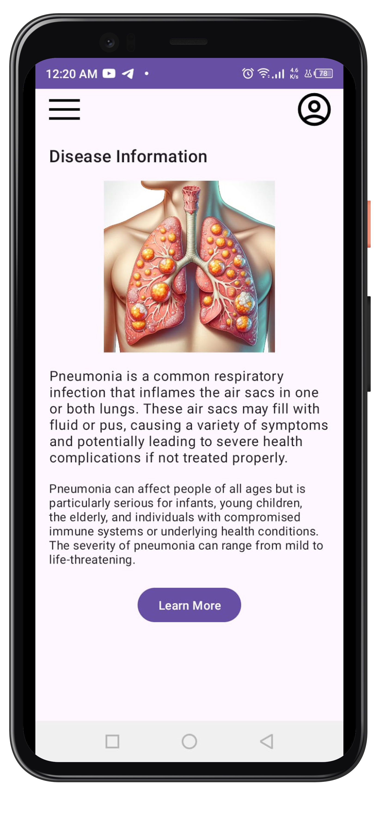
PneumoScan
Disease Activity
class DiseaseActivity : BaseActivity() { override fun onCreate(savedInstanceState: Bundle?) { super.onCreate(savedInstanceState) layoutInflater.inflate(R.layout.activity_disease, findViewById(R.id.content_frame)) setNavigationViewItemChecked(R.id.nav_disease)
How does the app work?
val learnMoreButton: Button = findViewById(R.id.learnMoreButton) learnMoreButton.setOnClickListener { Toast.makeText(this, "Learn more about diseases.", Toast.LENGTH_SHORT).show() // Open the URL in a web browser val url = "https://en.wikipedia.org/wiki/Pneumonia" val intent = Intent(Intent.ACTION_VIEW) intent.data = Uri.parse(url) startActivity(intent) }

Slide 13
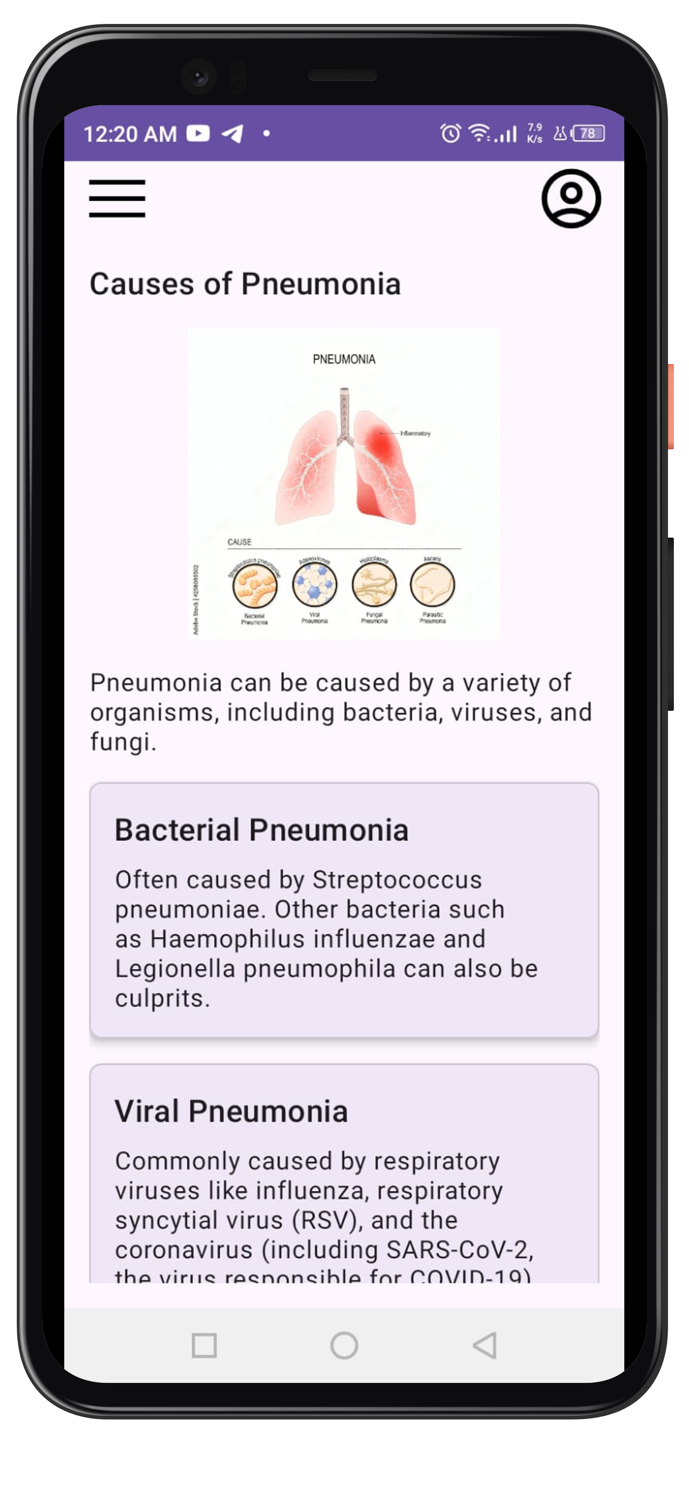
PneumoScan
Disease Activity
<com.google.android.material.card.MaterialCardView android:layout_width="match_parent" android:layout_height="wrap_content" android:layout_marginBottom="16dp" app:cardCornerRadius="8dp" app:cardElevation="4dp"> <LinearLayout android:layout_width="match_parent" android:layout_height="wrap_content" android:orientation="vertical" android:padding="16dp"> <TextView android:layout_width="wrap_content" android:layout_height="wrap_content" android:text="Bacterial Pneumonia" android:textAppearance="?attr/textAppearanceHeadline6" android:layout_marginBottom="8dp"/> < </LinearLayout> </com.google.android.material.card.MaterialCardView>
How does the app work?

Slide 14
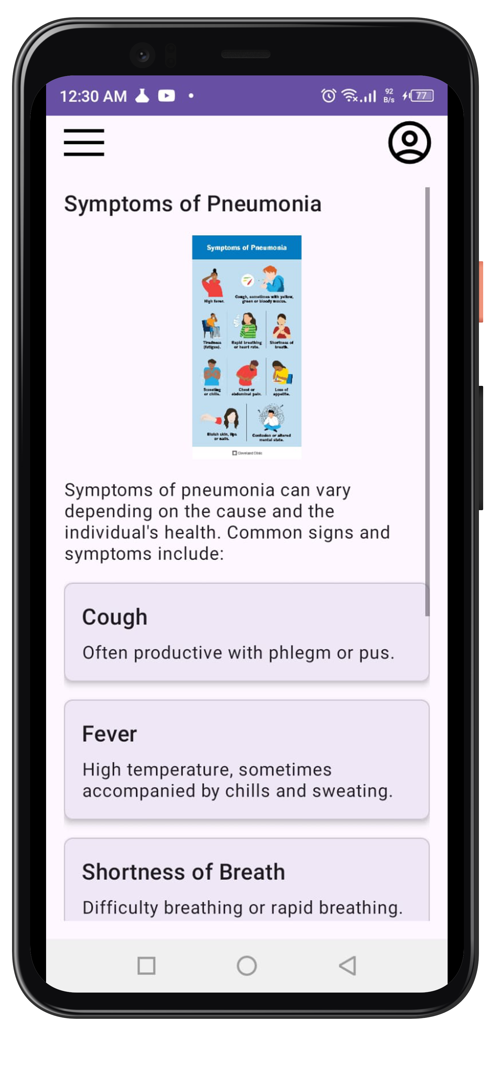
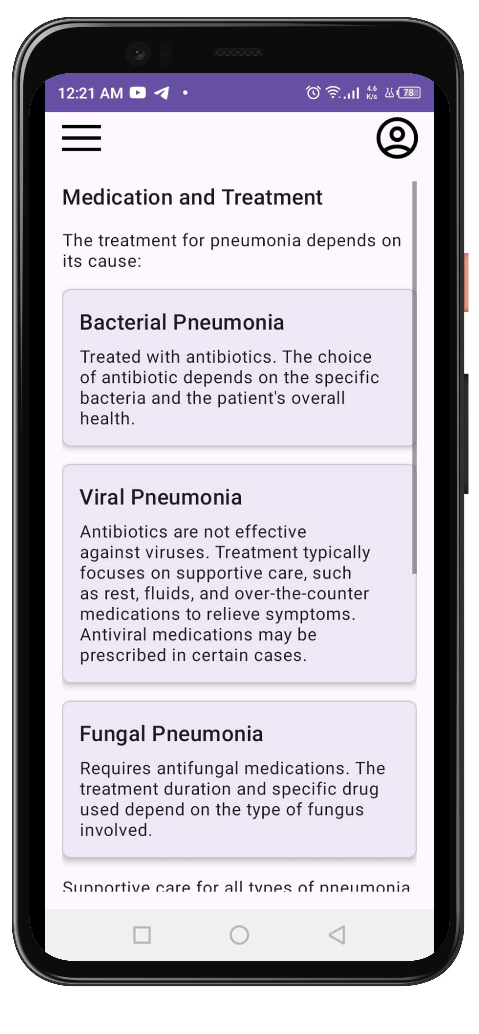
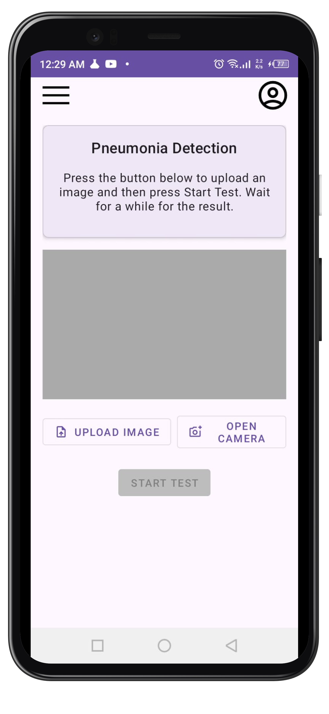

Slide 15
PneumoScan
Causes Activity
<com.google.android.material.card.MaterialCardView android:layout_width="match_parent" android:layout_height="wrap_content" android:layout_marginBottom="16dp" app:cardCornerRadius="8dp" app:cardElevation="4dp"> <LinearLayout android:layout_width="match_parent" android:layout_height="wrap_content" android:orientation="vertical" android:padding="16dp"> <TextView android:layout_width="wrap_content" android:layout_height="wrap_content" android:text="Bacterial Pneumonia" android:textAppearance="?attr/textAppearanceHeadline6" android:layout_marginBottom="8dp"/> </LinearLayout> </com.google.android.material.card.MaterialCardView>
How does the app work?

Slide 16
PneumoScan
Testing Activity
buttonSelectImage.setOnClickListener { val intent = Intent(Intent.ACTION_PICK, MediaStore.Images.Media.EXTERNAL_CONTENT_URI) startActivityForResult(intent, REQUEST_IMAGE_PICK) } buttonOpenCamera.setOnClickListener { val intent = Intent(MediaStore.ACTION_IMAGE_CAPTURE) startActivityForResult(intent, REQUEST_IMAGE_CAPTURE) }
How does the app work?
buttonStartTest.isEnabled = false buttonStartTest.setBackgroundColor(resources.getColor(R.color.grey))

Slide 17
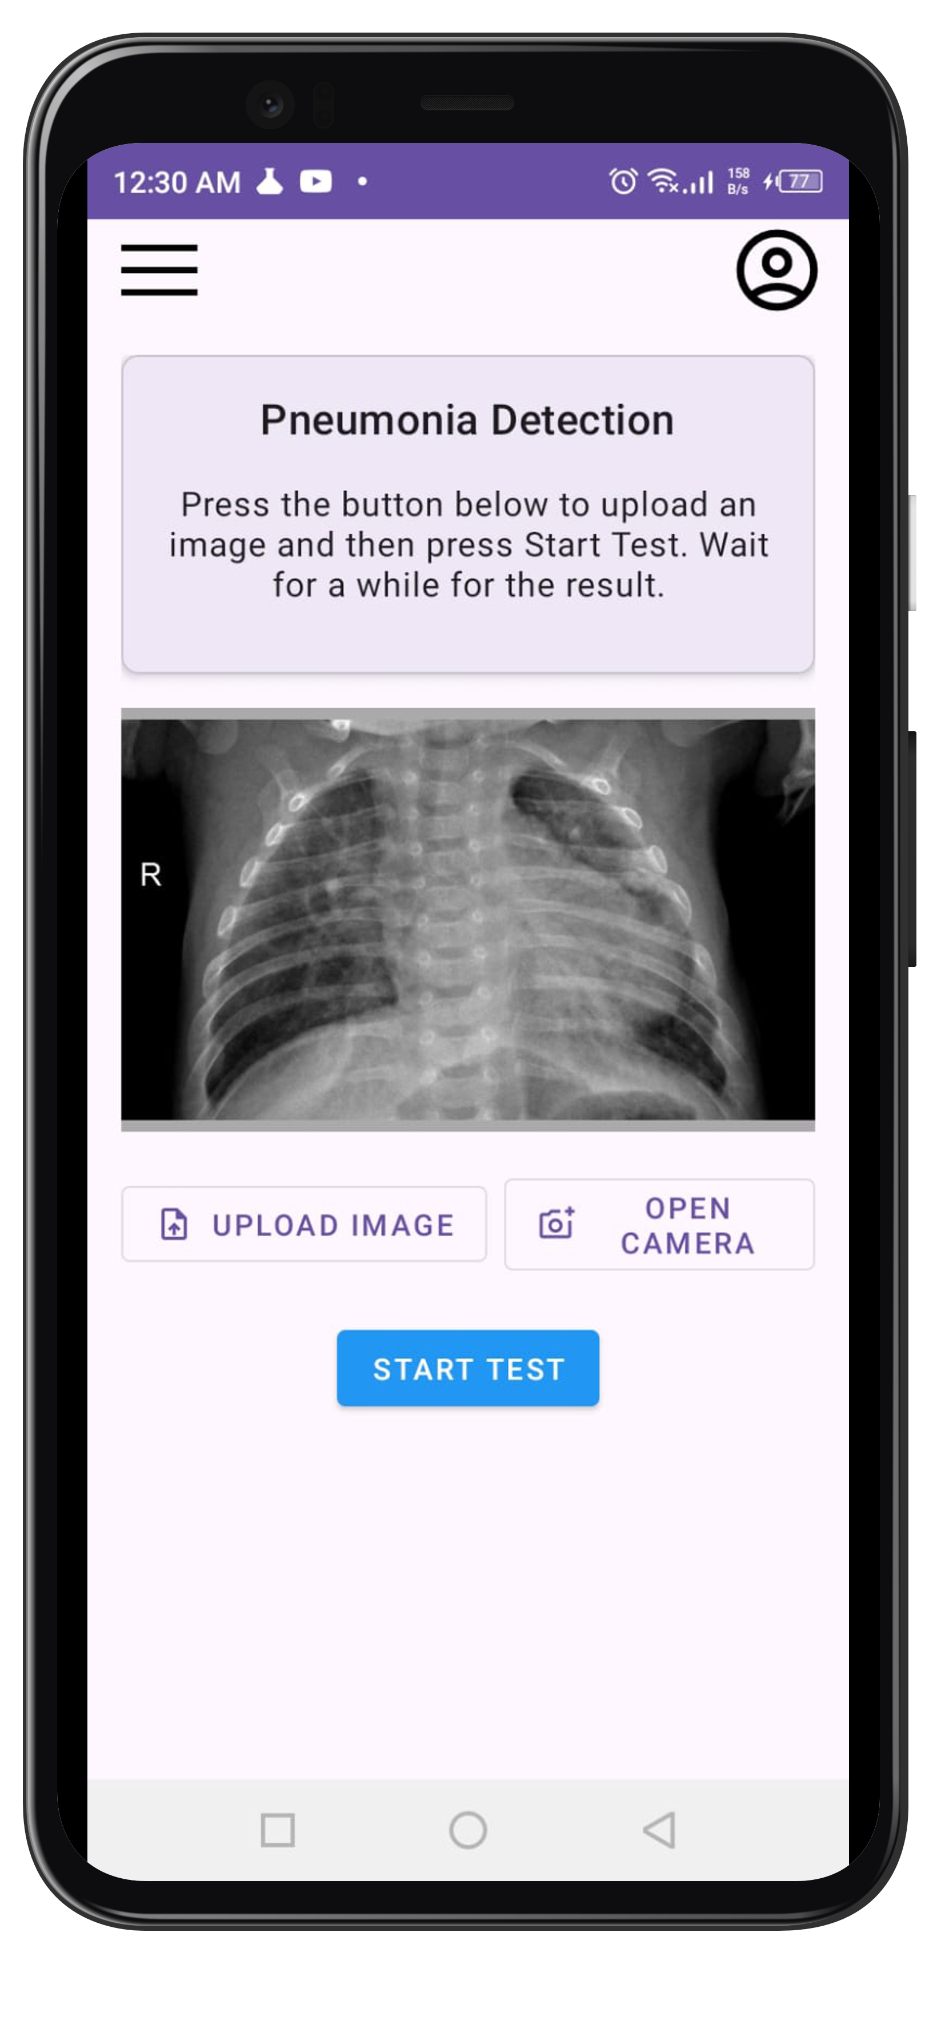
PneumoScan
Testing Activity
buttonSelectImage.setOnClickListener { val intent = Intent(Intent.ACTION_PICK, MediaStore.Images.Media.EXTERNAL_CONTENT_URI) startActivityForResult(intent, REQUEST_IMAGE_PICK) } buttonOpenCamera.setOnClickListener { val intent = Intent(MediaStore.ACTION_IMAGE_CAPTURE) startActivityForResult(intent, REQUEST_IMAGE_CAPTURE) }
How does the app work?
buttonStartTest.isEnabled = false buttonStartTest.setBackgroundColor(resources.getColor(R.color.grey))
private fun onImageAttached() { buttonStartTest.isEnabled = true buttonStartTest.setBackgroundColor(resources.getColor(R.color.blue)) }

Slide 18
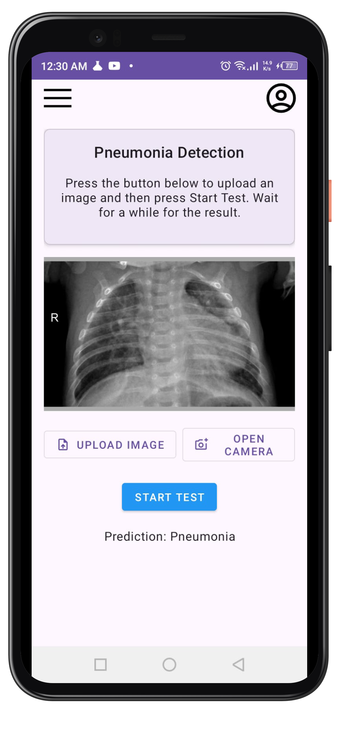
PneumoScan
Testing Activity
buttonSelectImage.setOnClickListener { val intent = Intent(Intent.ACTION_PICK, MediaStore.Images.Media.EXTERNAL_CONTENT_URI) startActivityForResult(intent, REQUEST_IMAGE_PICK) } buttonOpenCamera.setOnClickListener { val intent = Intent(MediaStore.ACTION_IMAGE_CAPTURE) startActivityForResult(intent, REQUEST_IMAGE_CAPTURE) }
How does the app work?
buttonStartTest.isEnabled = false buttonStartTest.setBackgroundColor(resources.getColor(R.color.grey))
progressBar.visibility = ProgressBar.GONE if (response.isSuccessful) { val result = response.body()?.prediction textViewResult.text = "Prediction: $result" } else { Toast.makeText(this@TestingActivity, "Error: ${response.message()}", Toast.LENGTH_SHORT).show() } } override fun onFailure(call: Call<PredictionResponse>, t: Throwable) { progressBar.visibility = ProgressBar.GONE Toast.makeText(this@TestingActivity, "Failed: ${t.message}", Toast.LENGTH_SHORT).show()

Slide 19
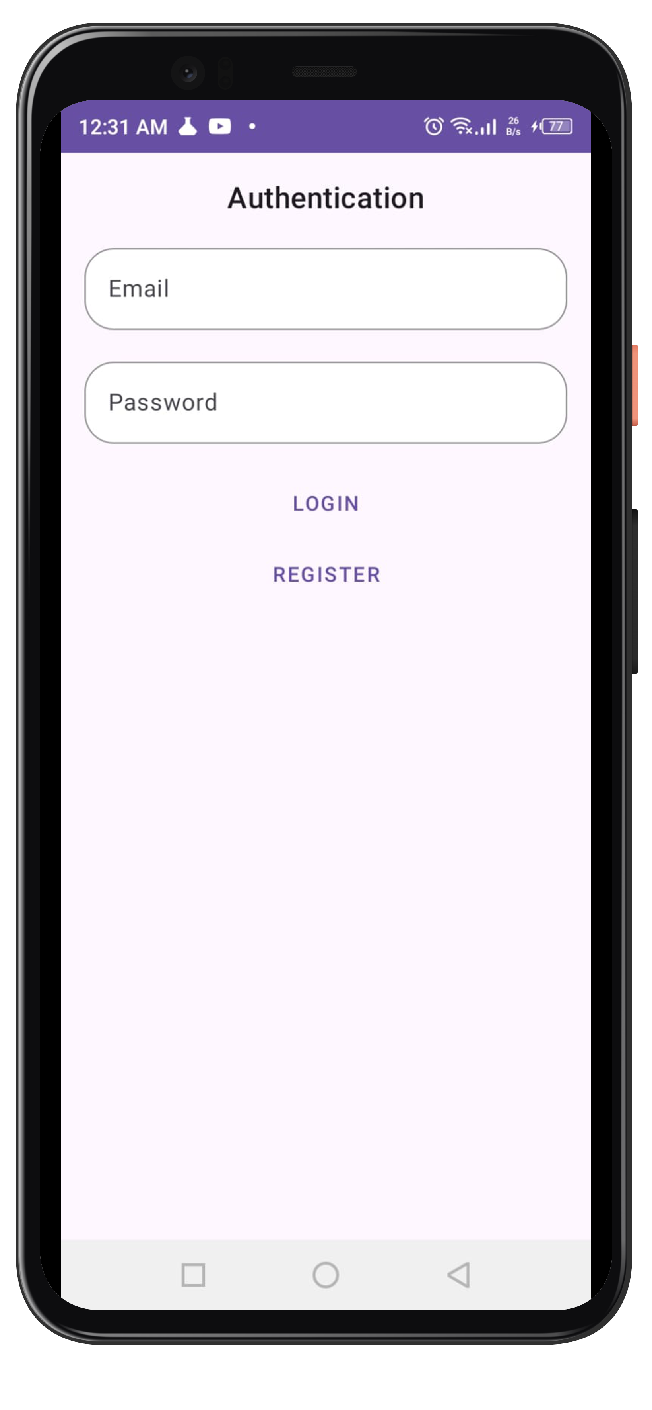
PneumoScan
Authentication Activity
How does the app work?

Slide 20
PneumoScan
Authentication Activity
btnLogin.setOnClickListener { val email = etUsername.text.toString().trim() val password = etPassword.text.toString().trim() if (email.isEmpty() || password.isEmpty()) { Toast.makeText(this, "Please enter email and password", Toast.LENGTH_SHORT).show() return@setOnClickListener } viewModel.login(email, password) }
How does the app work?

Slide 21
PneumoScan
Authentication Activity
btnLogin.setOnClickListener { val email = etUsername.text.toString().trim() val password = etPassword.text.toString().trim() if (email.isEmpty() || password.isEmpty()) { Toast.makeText(this, "Please enter email and password", Toast.LENGTH_SHORT).show() return@setOnClickListener } viewModel.login(email, password) }
How does the app work?
viewModel.loginStatus.observe(this, Observer { result -> result.onSuccess { user -> Toast.makeText(this, "Hello ${user.firstName}!", Toast.LENGTH_SHORT).show() val intent = Intent(this, MainActivity::class.java) intent.putExtra("USER_ID", user.userId) startActivity(intent) finish() }.onFailure { exception -> Toast.makeText(this, exception.message ?: "Authentication failed", Toast.LENGTH_SHORT).show() }

Slide 22
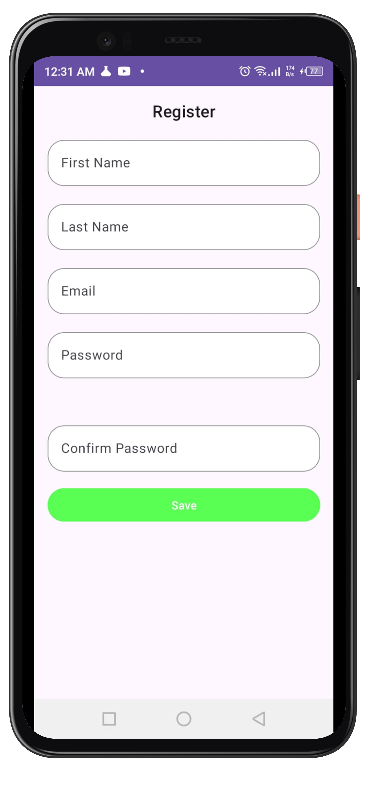
PneumoScan
Registration Activity
if (firstName.isEmpty() || lastName.isEmpty() || email.isEmpty() || password.isEmpty() || confirmPassword.isEmpty()) { Toast.makeText(this, "Please fill in all fields", Toast.LENGTH_SHORT).show() return@setOnClickListener }
How does the app work?

Slide 23
PneumoScan
Registration Activity
if (firstName.isEmpty() || lastName.isEmpty() || email.isEmpty() || password.isEmpty() || confirmPassword.isEmpty()) { Toast.makeText(this, "Please fill in all fields", Toast.LENGTH_SHORT).show() return@setOnClickListener }
How does the app work?
if (!Patterns.EMAIL_ADDRESS.matcher(email).matches()) { Toast.makeText(this, "Please enter a valid email", Toast.LENGTH_SHORT).show() return@setOnClickListener }

Slide 24
PneumoScan
Registration Activity
if (firstName.isEmpty() || lastName.isEmpty() || email.isEmpty() || password.isEmpty() || confirmPassword.isEmpty()) { Toast.makeText(this, "Please fill in all fields", Toast.LENGTH_SHORT).show() return@setOnClickListener }
How does the app work?
if (!Patterns.EMAIL_ADDRESS.matcher(email).matches()) { Toast.makeText(this, "Please enter a valid email", Toast.LENGTH_SHORT).show() return@setOnClickListener }
if (password.length < 6) { Toast.makeText(this, "Password must be at least 6 characters long", Toast.LENGTH_SHORT).show() return@setOnClickListener }

Slide 25
PneumoScan
Registration Activity
if (firstName.isEmpty() || lastName.isEmpty() || email.isEmpty() || password.isEmpty() || confirmPassword.isEmpty()) { Toast.makeText(this, "Please fill in all fields", Toast.LENGTH_SHORT).show() return@setOnClickListener }
How does the app work?
if (!Patterns.EMAIL_ADDRESS.matcher(email).matches()) { Toast.makeText(this, "Please enter a valid email", Toast.LENGTH_SHORT).show() return@setOnClickListener }
if (password.length < 6) { Toast.makeText(this, "Password must be at least 6 characters long", Toast.LENGTH_SHORT).show() return@setOnClickListener }
if (!isPasswordStrong(password)) { Toast.makeText(this, "Password must contain lowercase, uppercase, number, and symbol", Toast.LENGTH_SHORT).show() return@setOnClickListener }

Slide 26
PneumoScan
Registration Activity
if (firstName.isEmpty() || lastName.isEmpty() || email.isEmpty() || password.isEmpty() || confirmPassword.isEmpty()) { Toast.makeText(this, "Please fill in all fields", Toast.LENGTH_SHORT).show() return@setOnClickListener }
How does the app work?
if (!Patterns.EMAIL_ADDRESS.matcher(email).matches()) { Toast.makeText(this, "Please enter a valid email", Toast.LENGTH_SHORT).show() return@setOnClickListener }
if (password.length < 6) { Toast.makeText(this, "Password must be at least 6 characters long", Toast.LENGTH_SHORT).show() return@setOnClickListener }
if (!isPasswordStrong(password)) { Toast.makeText(this, "Password must contain lowercase, uppercase, number, and symbol", Toast.LENGTH_SHORT).show() return@setOnClickListener }
if (password != confirmPassword) { Toast.makeText(this, "Passwords do not match", Toast.LENGTH_SHORT).show() return@setOnClickListener }

Slide 27
Thank You
CS
Made by:
Siraj Khan Umair Ahmad
Institute of Space
Technology

